Slide 1
BOLT UBC Datathon 2022
Presented By: Bryan Chang, Sriram Jayakumar, Michael Leung, Devon Wu and Allen Zhu
Team 28

Slide 2
We acknowledge that we are presenting from the traditional and unceded territories of the Musqueam, Squamish, Tsleil-Waututh, Niitsitapi (Blackfoot), Tsuu T’ina, and Metis First Nations peoples.

Slide 3

Meet Sam!
Just spent a year working as a sales representative in Summit Biotech
started sales career at age 16 in their hometown of Toronto
relocated to Vancouver to work for Summit Biotech despite the fact that all the work would be online
millennial
is single
lives in Langley (has to travel to downtown Vancouver for work)

Slide 4
However…
Sam has left Summit Biotech and did not leave any reviews regarding their time at Summit Biotech. Now, there are a few things about Sam that we found as common traits in employees who left Summit Biotech in 2021!

Slide 5
Key Findings

Slide 6
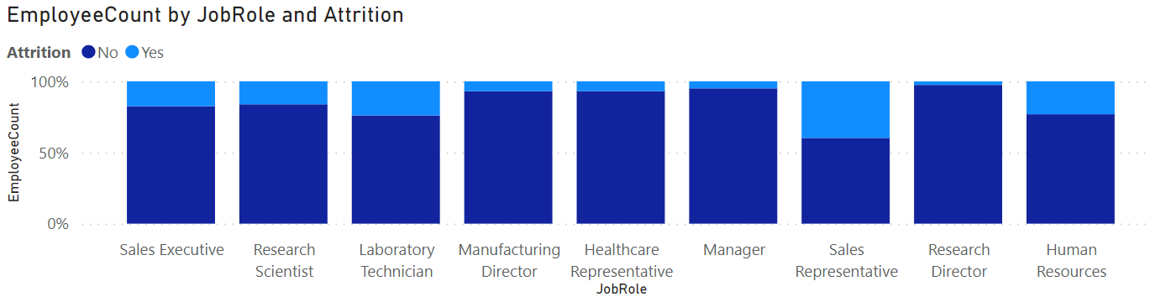
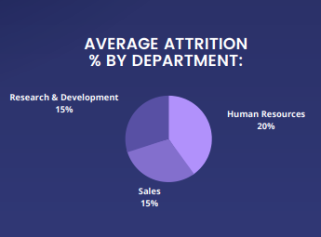
Job Attrition By Role
Attrition in every department was > 15%.
Specifically, the following jobs have had the highest attrition.
Sales Representative - 40%
Human Resources - 24%
Laboratory Technician - 24%

Slide 7
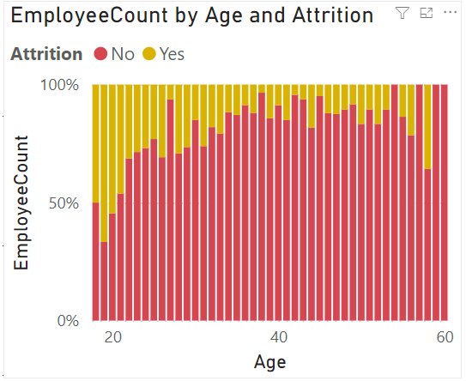
Job Attrition By Age
Younger people more likely to leave.

Slide 8
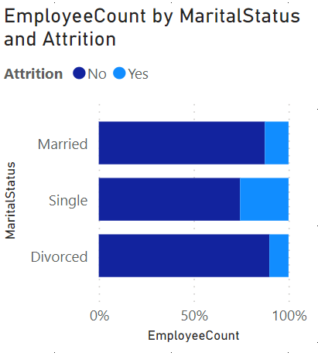
Job Attrition By Marital Status
Employees who identify as “single” were also the most willing to leave the company
This is likely due to how they don’t have the same financial responsibility as those with family/loved ones
More willing to try other opportunities before settling down
Attrition Rate:
Married - 18.5%
Single - 39%
Divorced - 10%

Slide 9
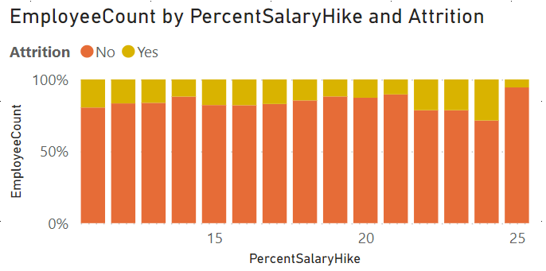
Job Attrition by Wage Hikes
Based on the graph, a higher wage hike % surprisingly correlated to a higher job attrition rate.
This trend is prevalent up to a 25% wage hike, after which attrition sharply drops.
Employees value something other than their salary, unless the salary increase was high enough (25% increase).

Slide 10
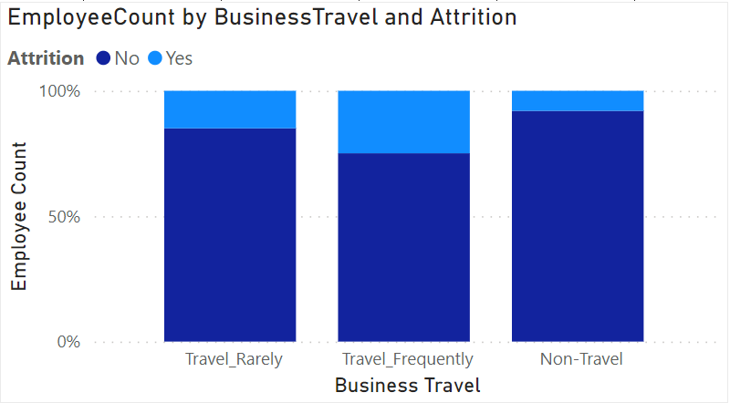
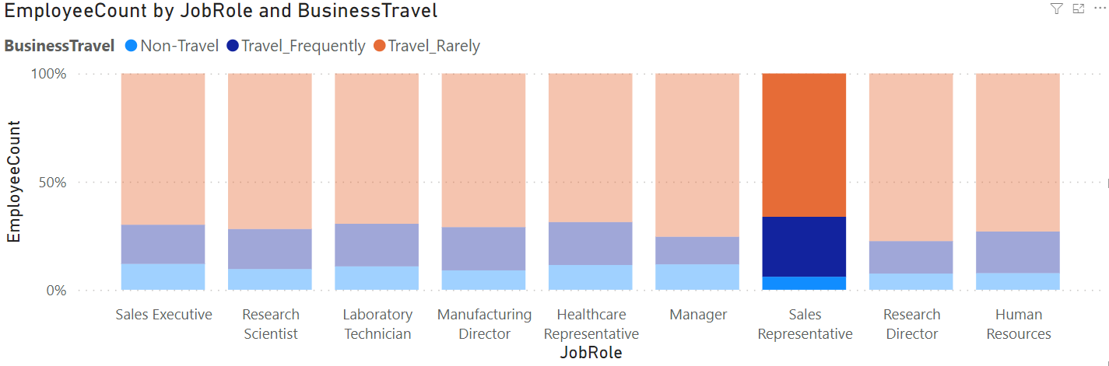
Job Attrition By Travel Frequency
People who travel for work related purposes were more likely to leave.
Sales representatives on average travel more than any other role.

Slide 11
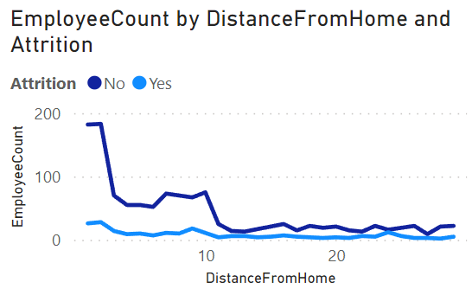
Job Attrition by Distance From Home
People who live closer to the company office are more likely to stay!

Slide 12
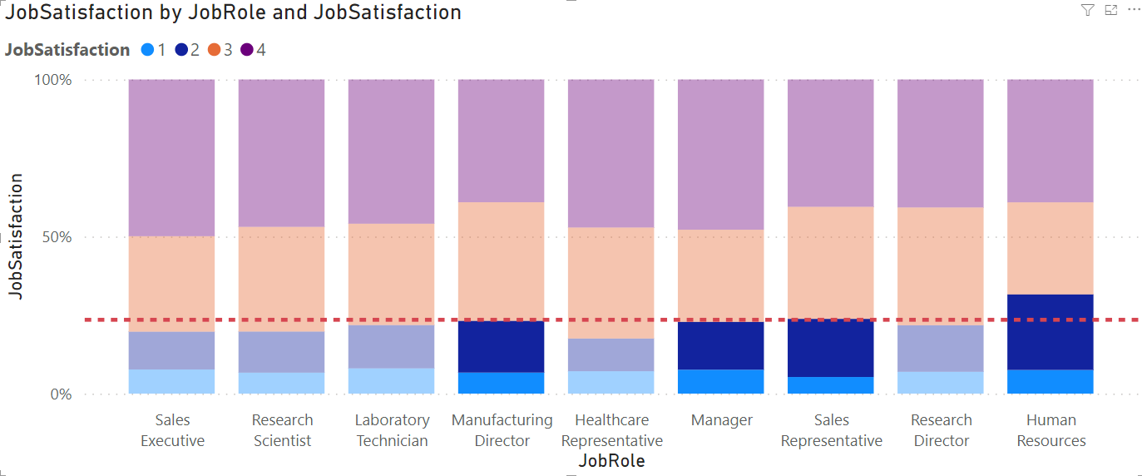
Jobs with the Highest Job Satisfaction
Human Resources, Manufacturing Director, Manager, and Sales Representatives appear to have the lowest job role satisfaction.

Slide 13
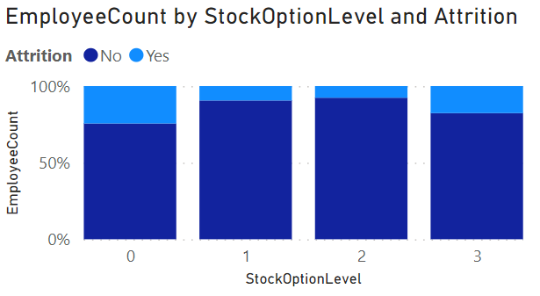
Job Stock Options
Appears that people with higher stock option levels are more likely to stay,
makes sense as they will likely be a senior member at the company who has settled down

Slide 14
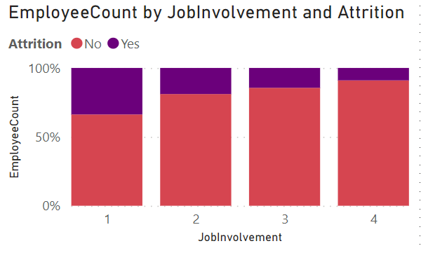

Job Involvement
People less involved are more likely to leave Summit Biotech.

Slide 15
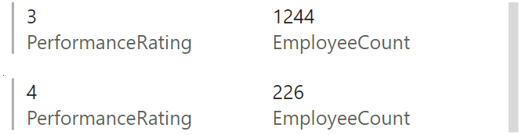
Job Attrition By Job Stat
Everyone had performance ratings of 3 or above, despite working from home.

Slide 16
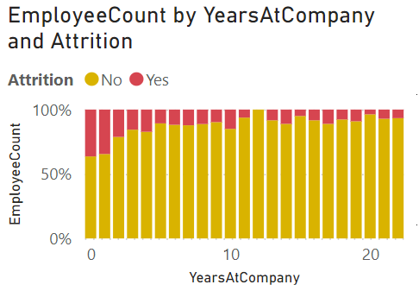
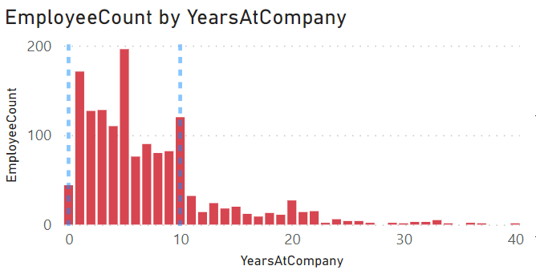
Job Attrition Employee Count by Years
People who have worked less years in company are more likely to leave.
Majority of people have worked between 0-10 years.

Slide 17
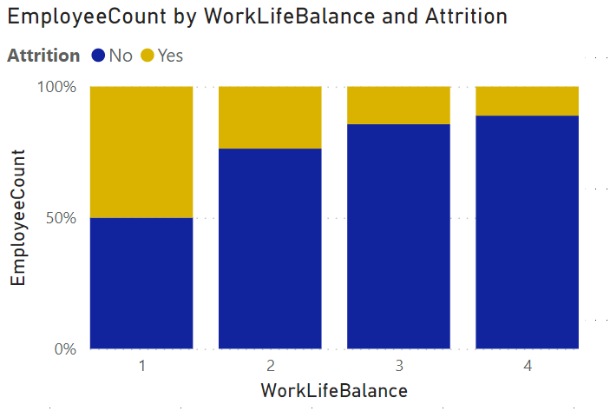
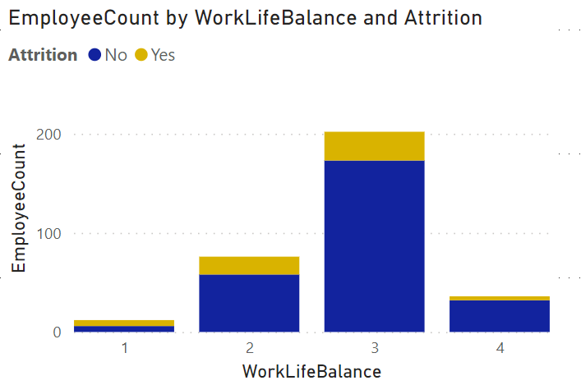

Job Attrition Employee
People who have a ‘better’ and ‘best’ work life balance are more likely to stay.
Likely higher due to working from home reducing commute time

Slide 18
Looking Deeper Into Subset

Slide 19

Individuals with Highest Turnover
People having largest impact on turnover
Single
People who travel for work
Least amount of job involvement and job satisfaction
Jobs as Sales Representatives specifically
Notes:
https://www.google.com/url?sa=i&url=https%3A%2F%2Fwww.everydayhealth.com%2Fcoronavirus%2Fhow-to-reduce-covid-19-risk-during-your-commute%2F&psig=AOvVaw1AzGBKRdh3LWd-XwqLloTY&ust=1652656494244000&source=images&cd=vfe&ved=0CAwQjRxqFwoTCPDH26yP4PcCFQAAAAAdAAAAABAD

Slide 20
Hypotheses for High Turnover
All Employees are all performing well, with ALL performance ratings of 3 or above
Despite this, a large portion of the company has low job satisfaction.
Exhibit D has some examples of supposed “issues” with employees:
“Back to Office” policy is frequently stated as an issue (all employees returning to office)
No support for Sales Representatives
Stock Options are not a major incentive
Employees feel undervalued and underpaid (especially Sales Representatives)
This is reflected in the job attrition rate, where the Sales Representative role has the highest attrition rate relative to the other jobs (40%).

Slide 21
Hypotheses for High Turnover Contd.
Exhibit E shows an inconsistency for training difficulty between Sales Representative, and other jobs.
Sales Reps have to do 40-50 hours of training in two weeks, whereas Lab Techs have to do 20 hours of training in two weeks.
Sales Reps are given new leads or have to find their own to continue working after their job ends.
Lab Techs have jobs where they are shadowed by a senior member.

Slide 22
Possible Solutions
Sales Reps should be our targeted group for reform as they are experiencing the most attrition.
Instead of forcing sales reps to work in offices, they should be allowed to work from home.
Should be allowed to work in groups or under guidance of a senior member instead of being given leads to work.
Jobs such as Human Resources and Lab Techs should be allowed to work from home whenever possible.
Would have little impact on job productivity (performance ratings are above 3) and will likely greatly improve employee satisfaction.
Notes:
Long term: have paid time off for sales reps

Slide 23
Measure of Implementing Solutions

Slide 24
Evaluating the Effectiveness of Our Solutions
EVALUATE USING DATA: collect data similar to the one provided for 2021.
see if attrition rates decrease across departments of concern (Lab Tech, Sales Rep, and Human Resources).
see if relationship satisfaction also increases since this appears to be a main concern amongst employers.
Need to wait minimum 1 year before evaluating whether the procedure is fully effective or not.
Monthly can be skewed since people are more likely to leave their jobs at certain times of the year.

Slide 25
Works Cited
https://worktraining.com/knowledge/online-training-effective/
https://news.vanderbilt.edu/2019/01/29/creating-space-within-law-for-nonbinary-genders/
https://www.google.com/url?sa=i&url=https%3A%2F%2Fwww.everydayhealth.com%2Fcoronavirus%2Fhow-to-reduce-covid-19-risk-during-your-commute%2F&psig=AOvVaw1AzGBKRdh3LWd-XwqLloTY&ust=1652656494244000&source=images&cd=vfe&ved=0CAwQjRxqFwoTCPDH26yP4PcCFQAAAAAdAAAAABAD

